Slide 1

SKY INSIGHTS: COMPREHENSIVE U.S AIRLINE DATA ANALYSIS
Done by
Pavithra M
20.08.2024

Slide 2

PROJECT DESCRIPTION
SCOPE
Analysis of U.S airline data to understand fare ,passenger trends,top airlines and market dynamics.
OBJECTIVES
Identify top airlines and routes based on passenger counts and mileage.
Analyze fare trends over different years and quarters.
Understand the distribution of fares across different carriers.
Explore the relationship between various variables like distance, fare, and market share.

Slide 3

DATA DESCRIPTION
tbl: Table identifier
Year: Year of the data record
quarter: Quarter of the year (1-4)
citymarketid_1 / citymarketid_2: Origin and destination city market IDs
city1 / city2: Origin and destination city names
airportid_1 / airportid_2: Origin and destination airport IDs
airport_1 / airport_2: Origin and destination airport codes
nsmiles: Distance between airports in miles
passengers: Number of passengers
fare: Average fare
carrier_lg / carrier_low: Codes for the largest and lowest fare carriers
large_ms / lf_ms: Market shares for the largest and lowest fare carriers
fare_lg / fare_low: Average fare for the largest and lowest fare carriers
Geocoded_City1 / Geocoded_City2: Geocoded coordinates for the cities
tbl1apk: Unique route identifier

Slide 4

ANALYSIS
.
Data Cleaning and Preparation:
Handling Missing Values: Imputed missing values using appropriate methods.
Outlier Detection and Treatment: Identified and addressed outliers to prevent data distortion.
Data Transformation: Scaled and normalized data to prepare for analysis.
Data Visualization:
Line Plots: Showed trends in fares and passenger counts over time.
Scatter Plots: Explored relationships between variables such as fare and market share.
Bar Charts: Displayed top airlines, city pairs, and other key metrics to compare and contrast data.
Correlation and Relationship Analysis:
Correlation Matrix: Explored relationships between variables such as fare, passenger counts, and market share.
Heatmap Visualization: Visualized the strength and direction of correlations between different variables.
Statistical Testing:
CHI SQUARE TEST: Compared year ranges and top city pairs across different years to assess statistical significance.
ONE WATY ANOVA: Tested for differences in average fare across multiple time periods

Slide 5
Passenger Analysis:
Top Airlines by Passenger Counts: Identified top 5 airlines with the highest total passenger volumes.
Trend Analysis: Aggregated passenger data by year and quarter to identify trends over time.
Fare Analysis:
Trend Analysis: Aggregated fare data by year and quarter to identify trends over time.
Average Fare Trends: Plotted average fares over different years to understand fare fluctuations.
Fare Distribution: Examined the distribution of fares across different carriers to highlight disparities.
City and Route Analysis:
Top Boarding and Destination Cities: Identified the top 5 cities for boarding and destination based on passenger volumes.
Top City Pairs: Determined the top 5 city pairs (routes) with the highest passenger traffic.
Market Share Analysis:
Top Airlines Identification: Determined the top 5 airlines based on the total passenger count.
Market Share Comparison: Analyzed the market share of the largest and lowest fare carriers to understand their dominance in the market.

Slide 6

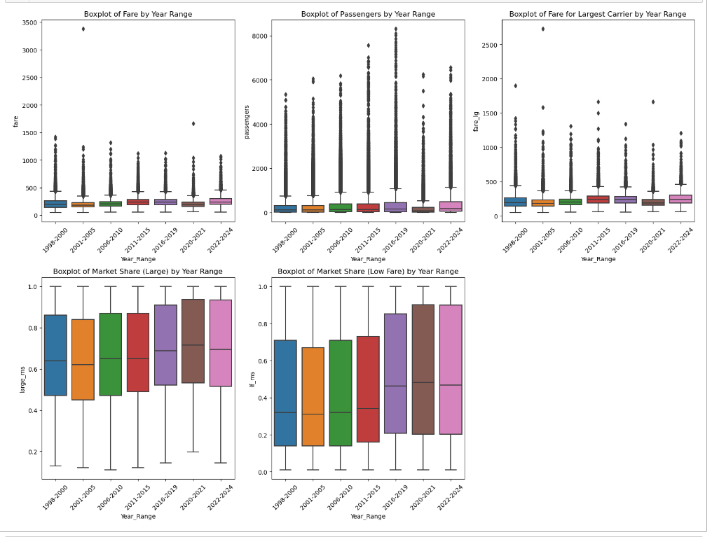
Checking for outliers
FARE BY YEAR RANGE
PASSENGERS BY YEAR RANGE
FARE FOR LARGEST CARRIER BY YEAR RANGE
MARKET SHARE OF CARRIER LARGE BY YEAR RANGE
MARKET SHARE OF CARRIER LOW BY YEAR RANGE

Slide 7

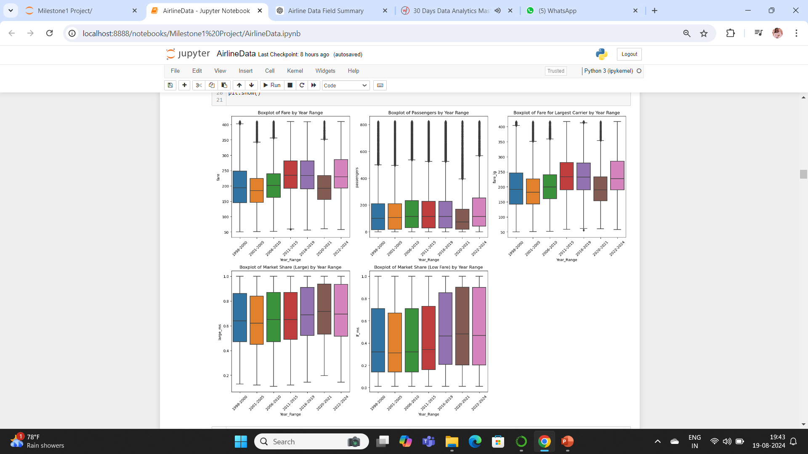
IQR formula : Replaced with Median
FARE BY YEAR RANGE
PASSENGERS BY YEAR RANGE
FARE FOR LARGEST CARRIER BY YEAR RANGE
MARKET SHARE OF CARRIER LARGE BY YEAR RANGE
MARKET SHARE OF CARRIER LOW BY YEAR RANGE

Slide 8
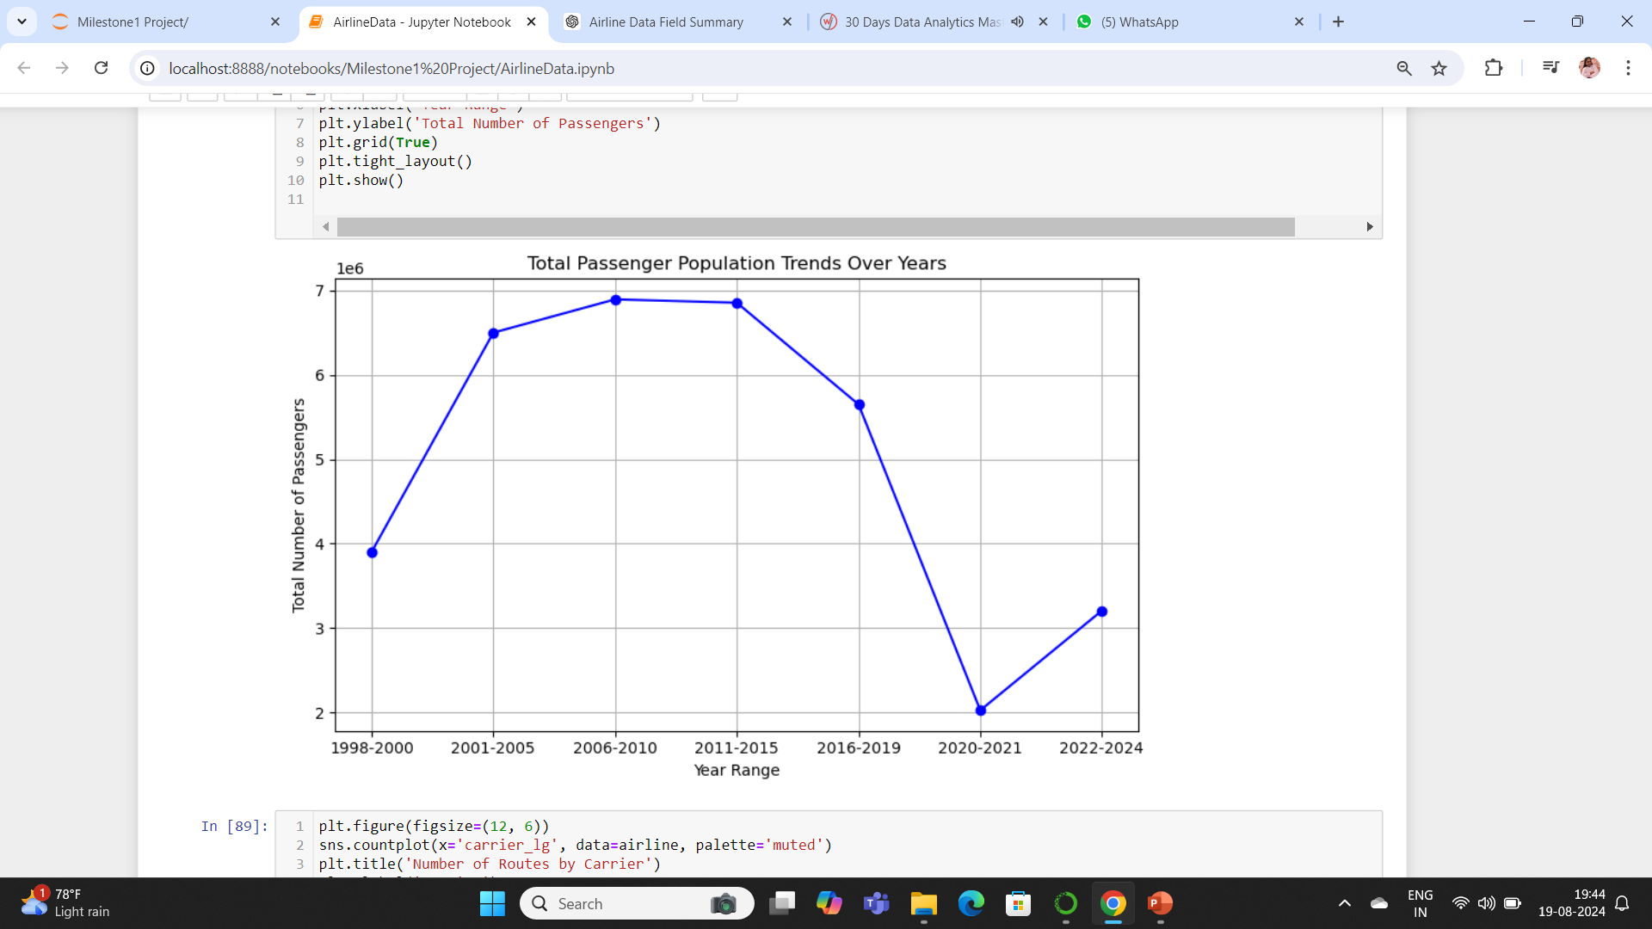
PASSENGER Population Trends
COVID 19
Resuming

Slide 9
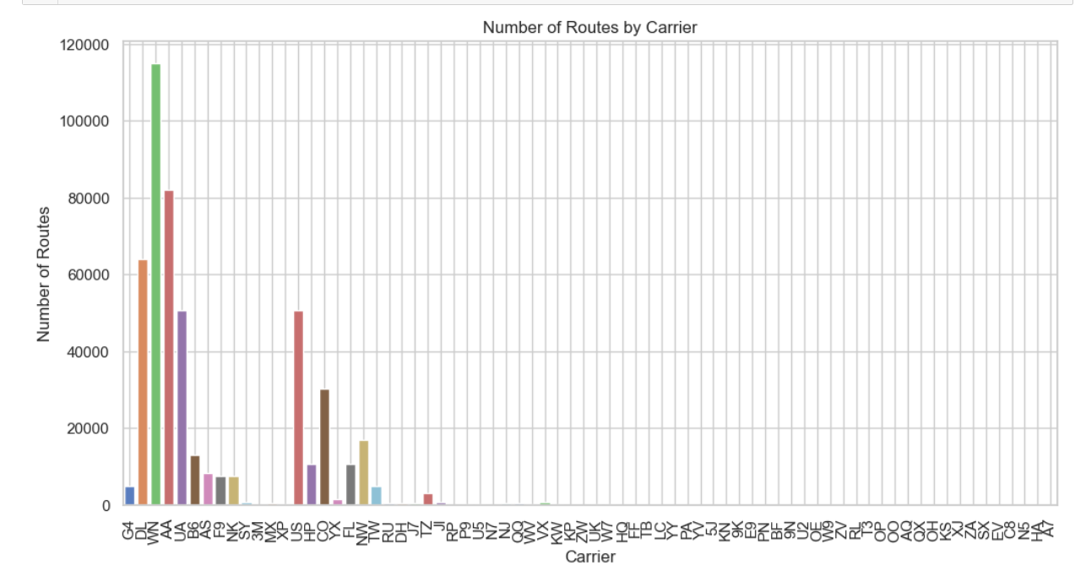
Route Counts by Airlines
Carrier large
67
Carrier low
71
Unique Carriers
72
Visible for overall Count ~ 20

Slide 10

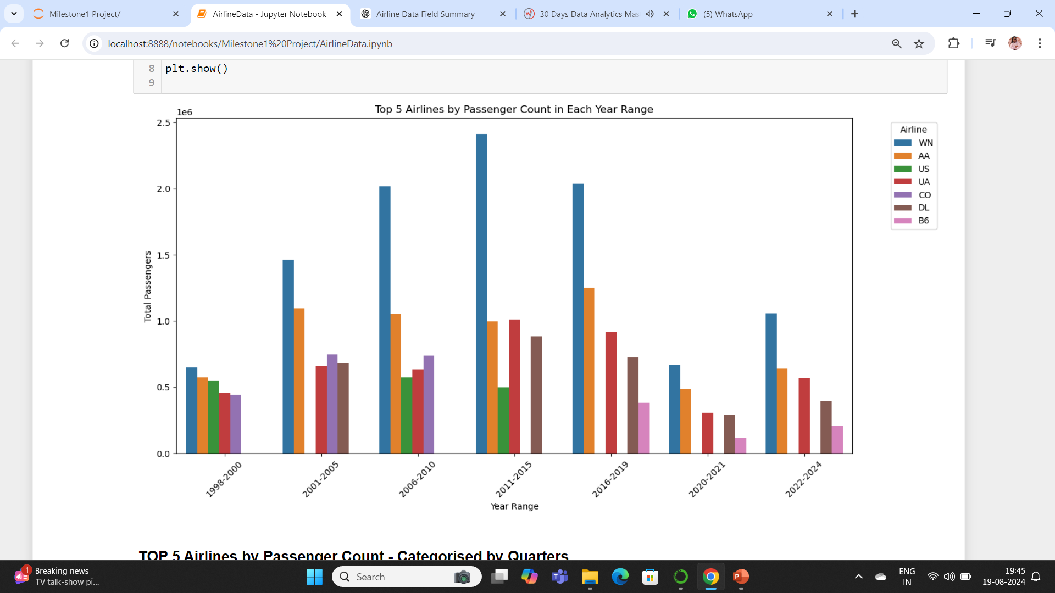
Top 5 Airlines by Passenger count
WN: Southwest Airlines
AA: American Airlines
UA: United Airlines
US: US Airways
CO: Continental Airlines
DL: Delta Air Lines
B6: JetBlue Airways

Slide 11
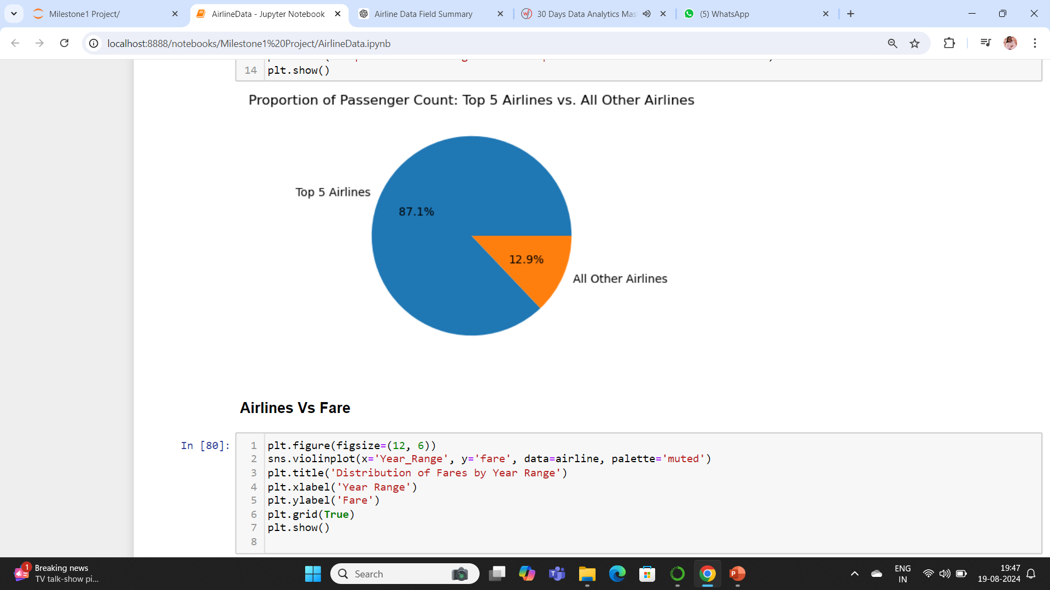
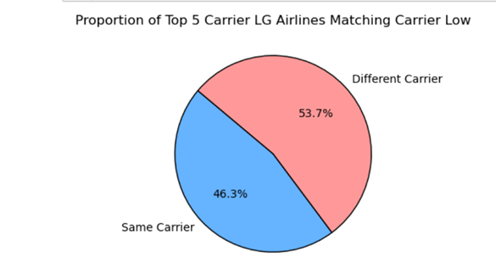
Proportion of Passenger count
Airlines in Carrier large replacing carrier low

Slide 12
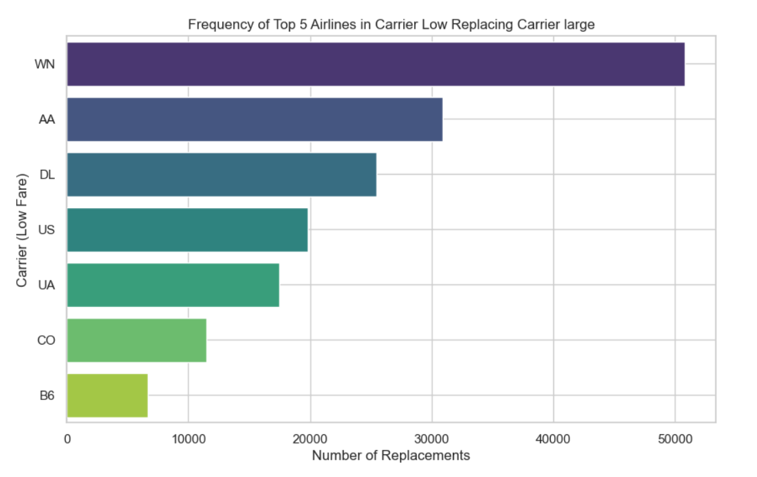
Frequency of Carrier low replacing Carrier large

Slide 13
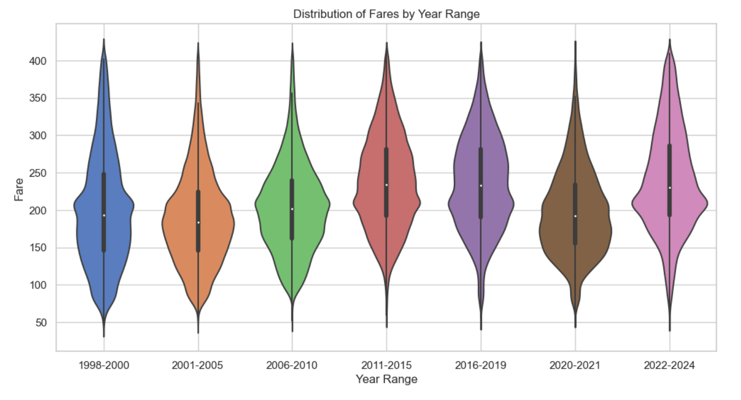
Distribution of Average Fare

Slide 14
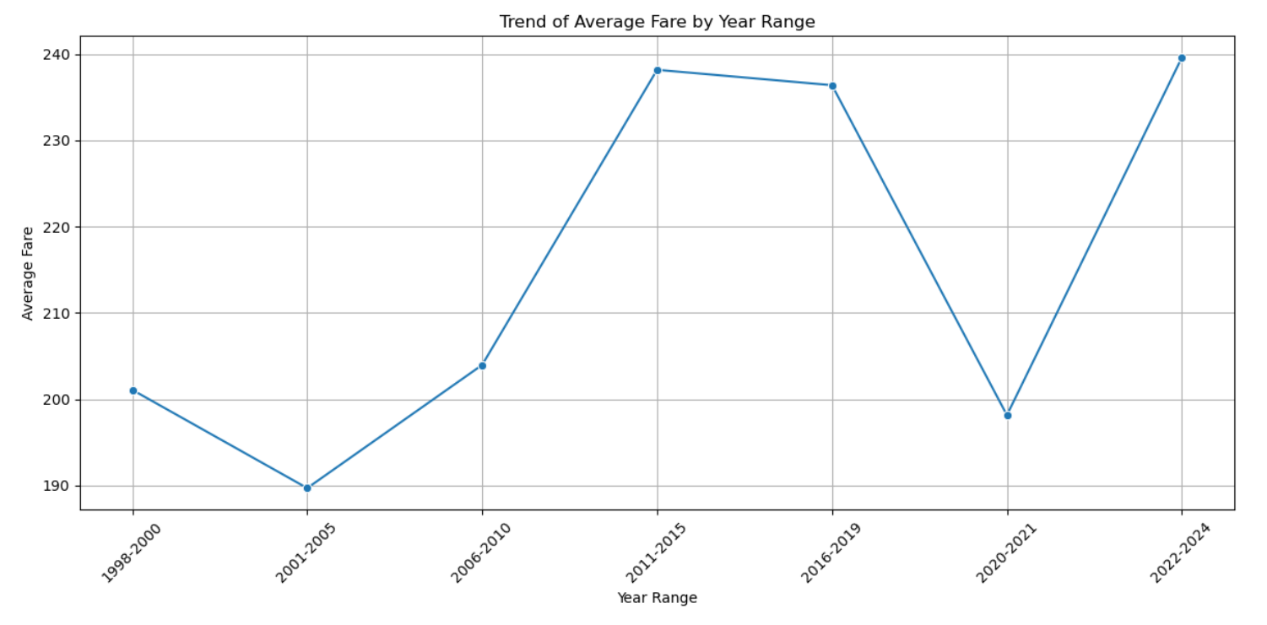
Average Fare Trends Across Different Years

Slide 15
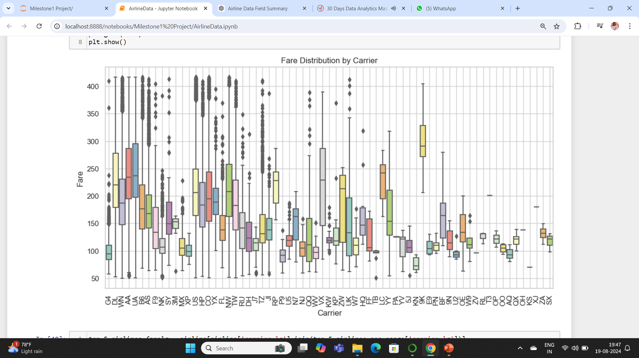
Fare Distribution Across Airlines
OPERATING COSTS
$
FUEL PRICES
$
LOYALTY PROGRAMS & PARTNERSHIPS
$
SERVICE LEVELS
$
ROUTE POPULARITY/DEMAND
$
MARKET COMPETITON
$
BOOKING TIME
$
FARE CLASSES
$

Slide 16
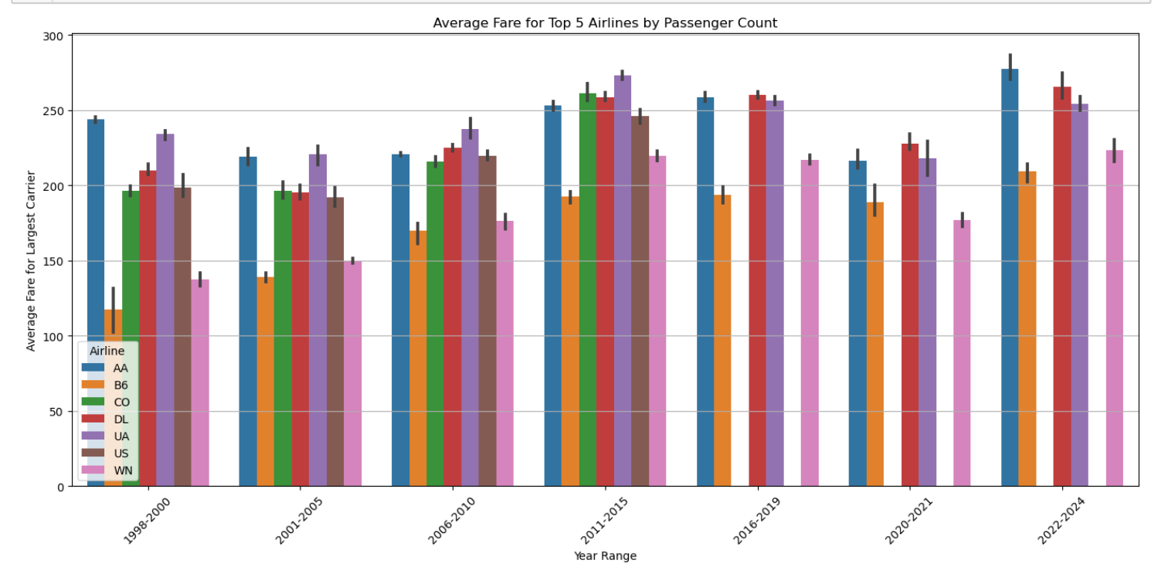
AVERAGE FARE FOR TOP 5 AIRLINES

Slide 17
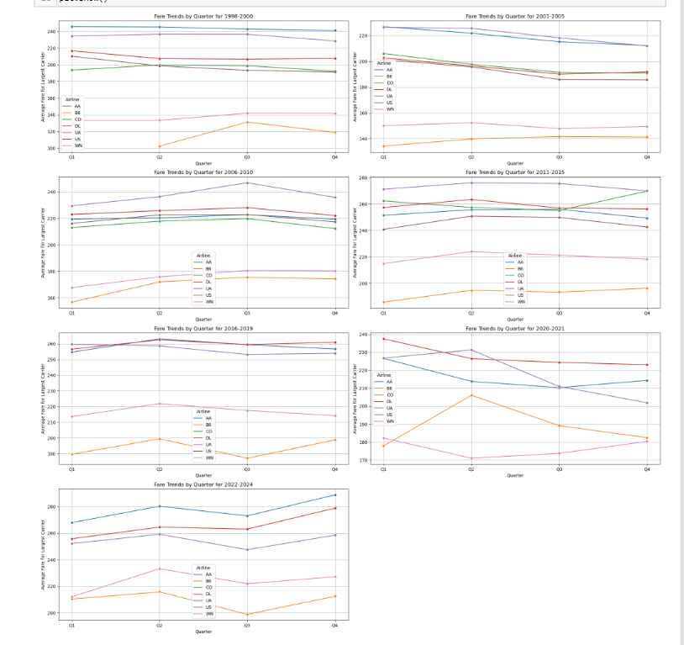
AVERAGE FARE FOR TOP 5 AIRLINES BY QUARTERS
Q1
1
4
3
Q2
2
1
1
Q3
3
2
4
Q4
4
3
2

Slide 18
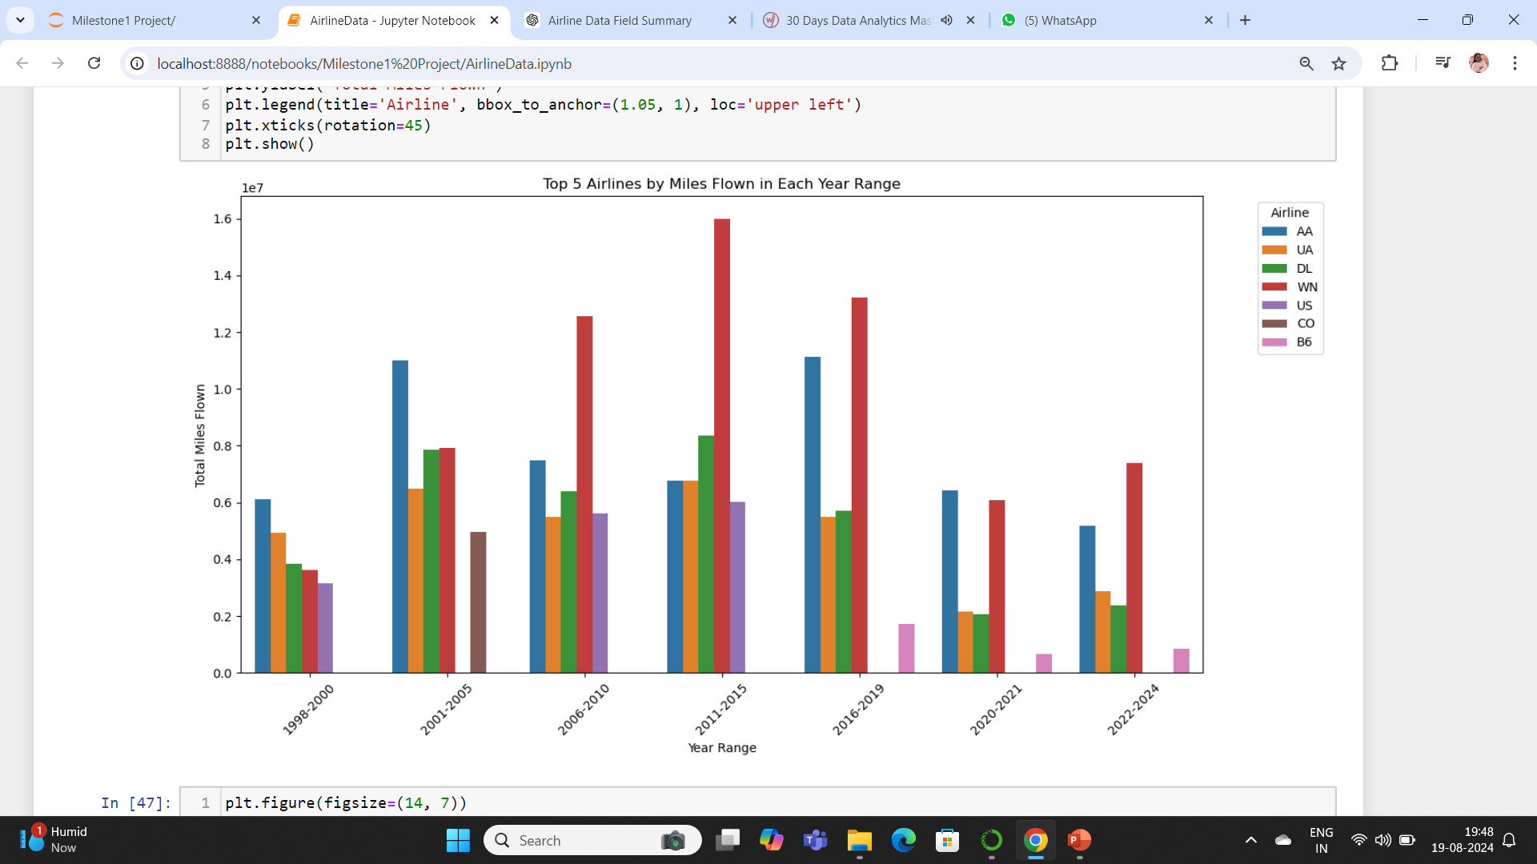
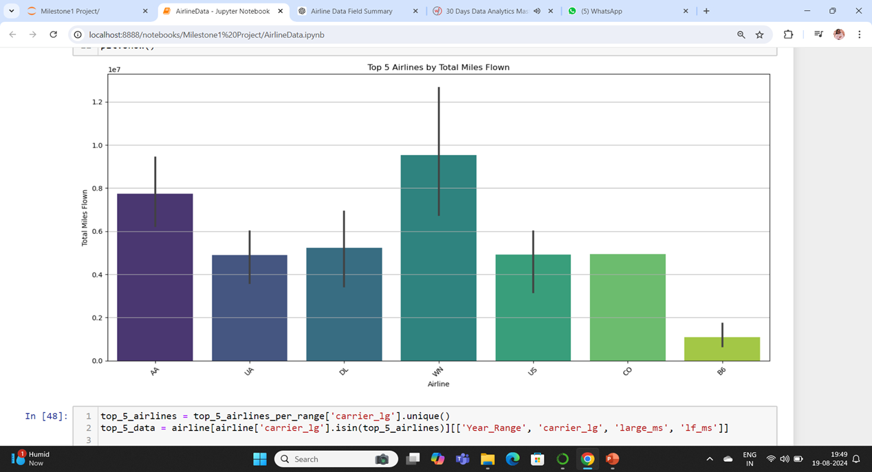
Top 5 Airlines by Total Miles Flown

Slide 19
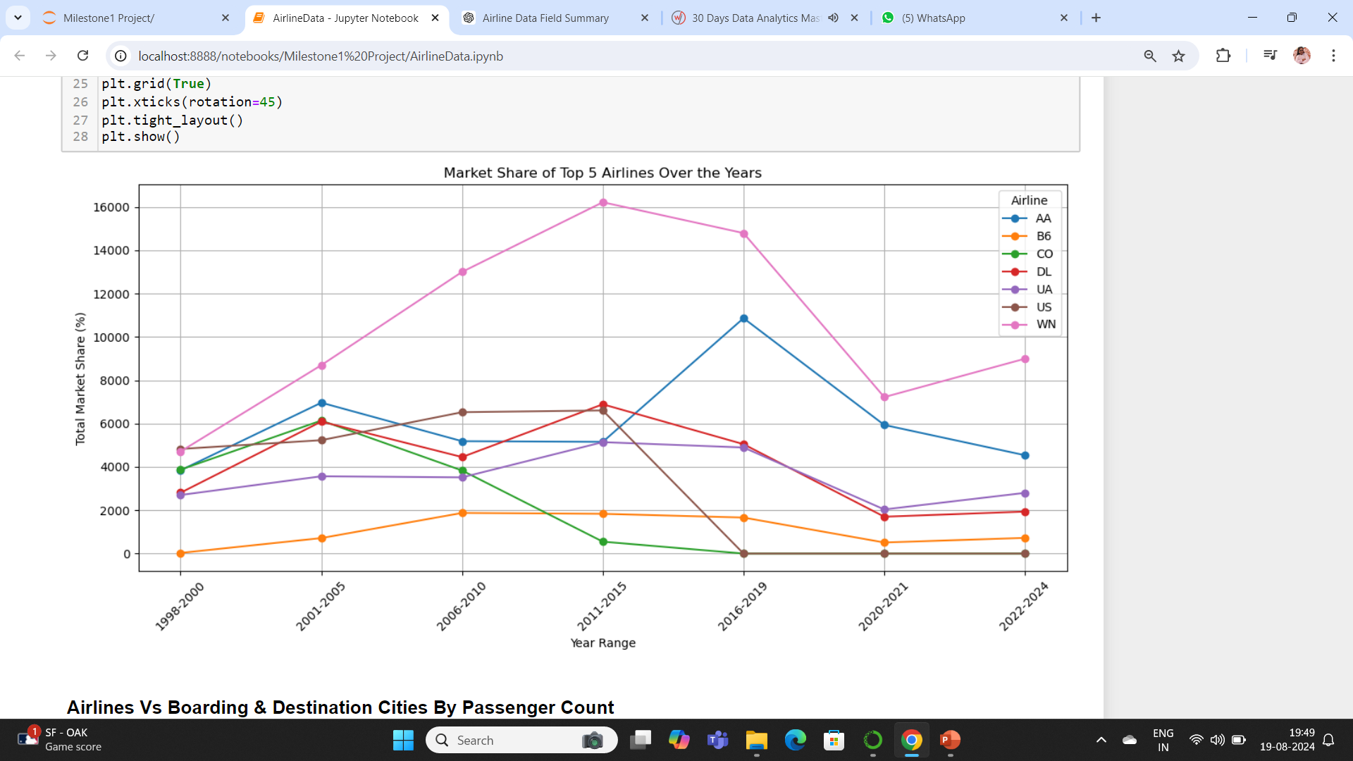
Market share of Top 5 Airlines

Slide 20
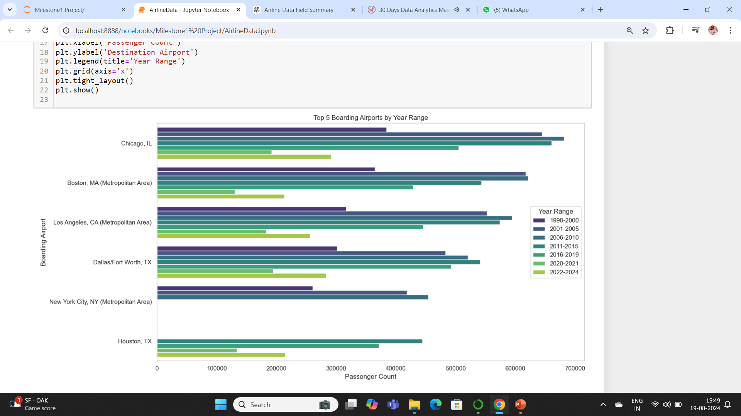
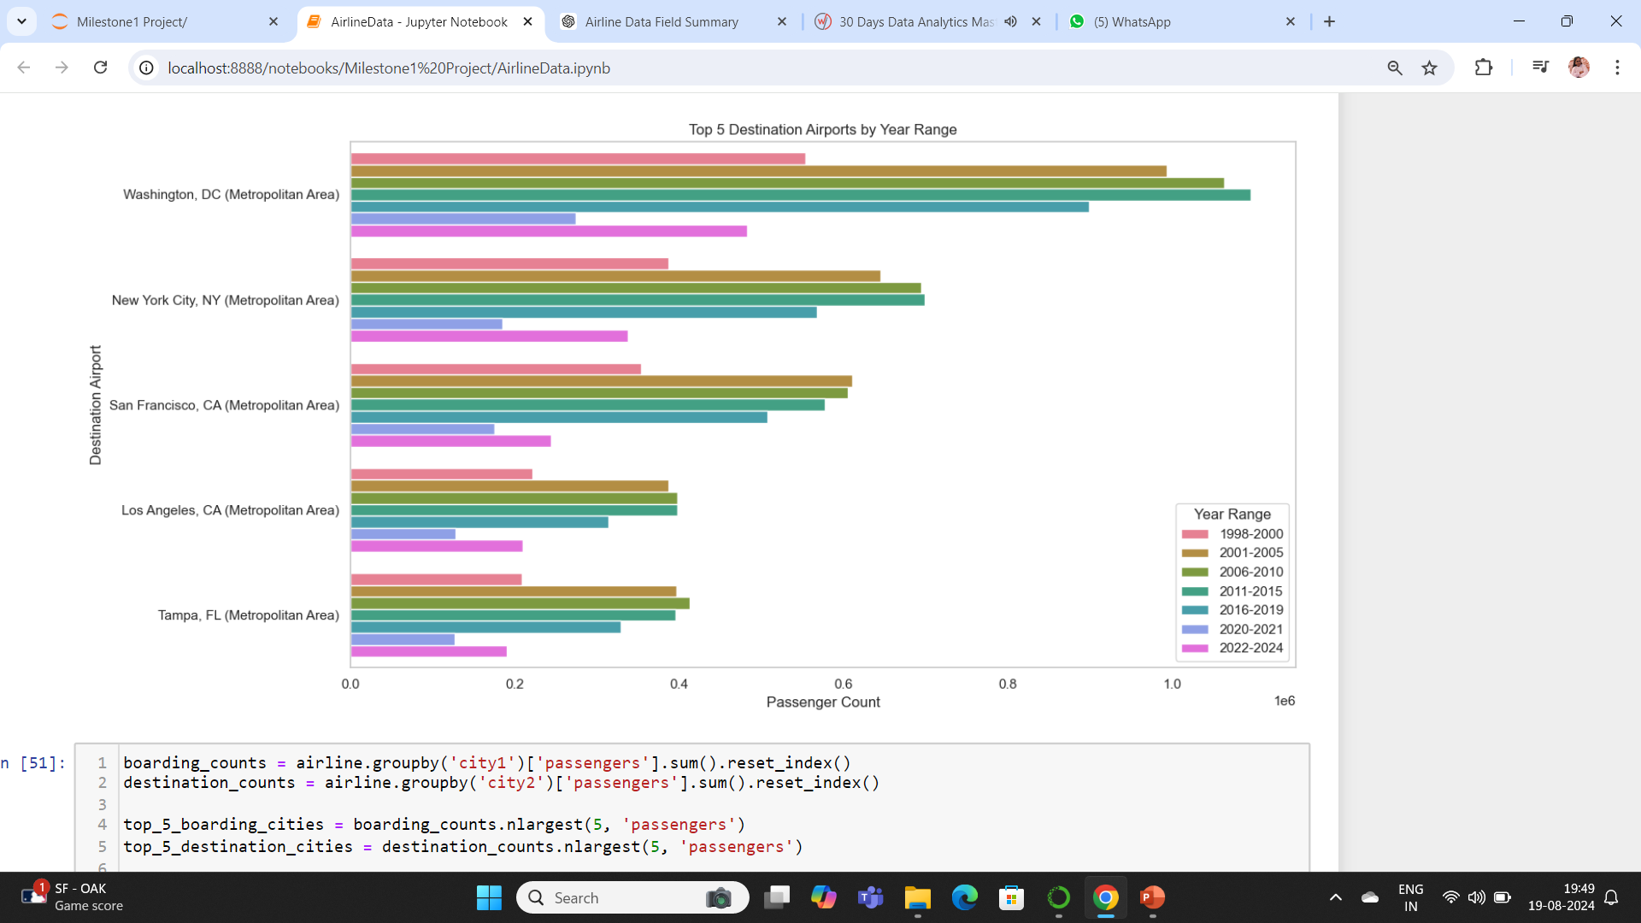
Top 5 Boarding And Destination Airports over Years

Slide 21
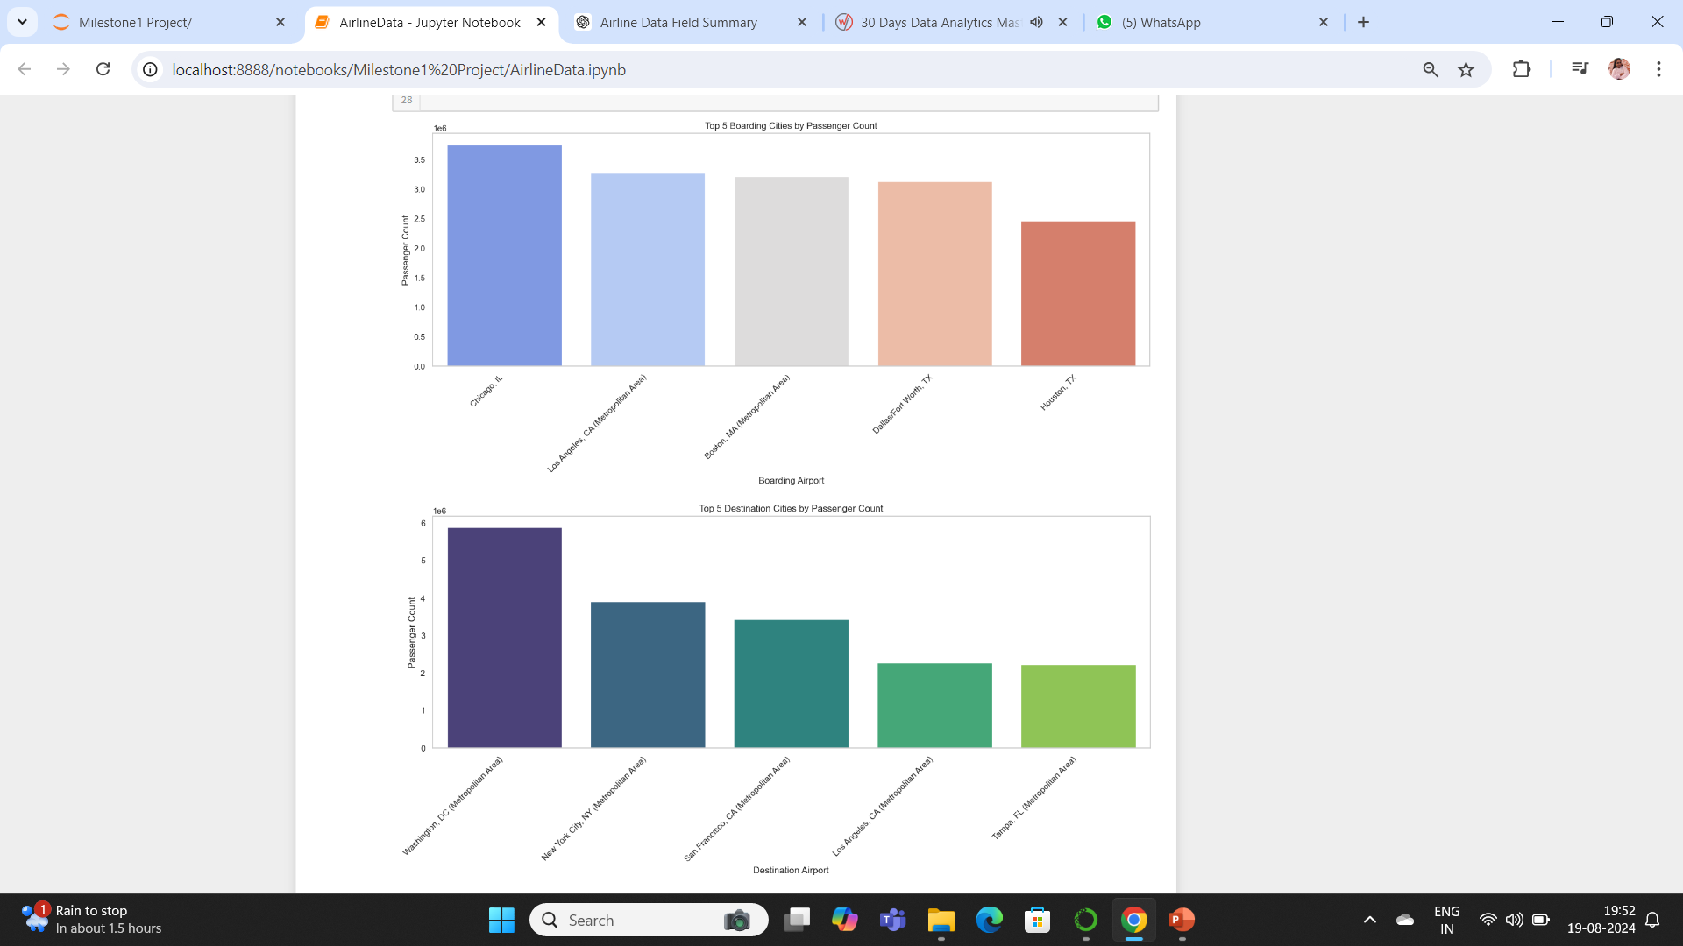
Top 5 Boarding And Destination Airports by Passenger count

Slide 22
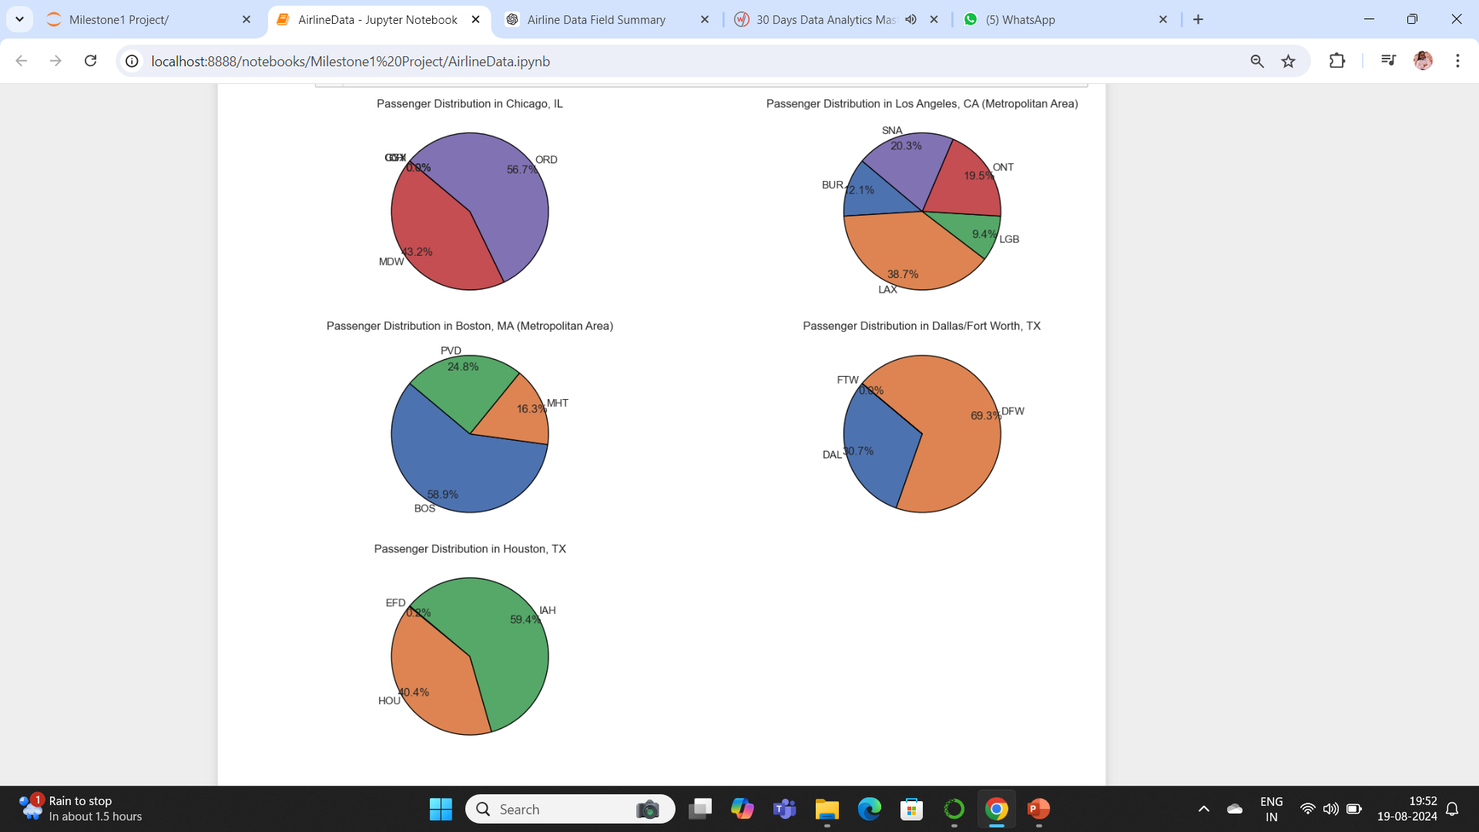
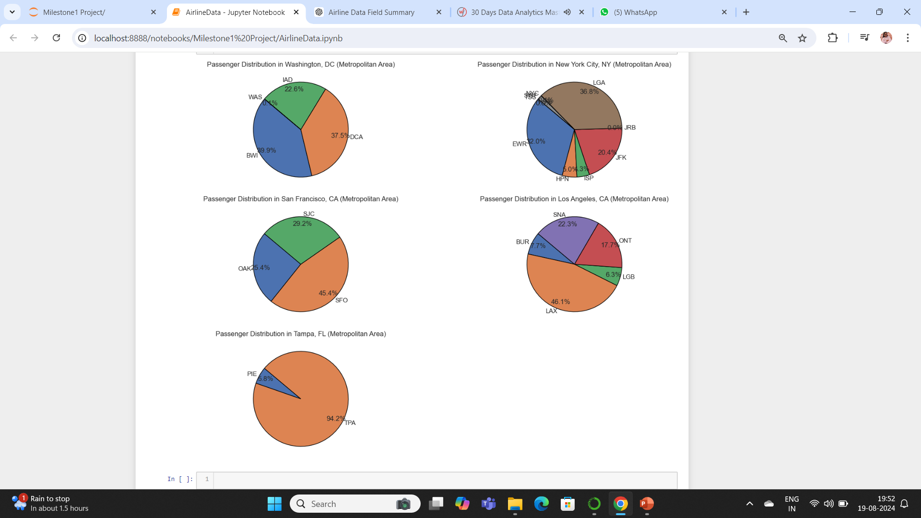
DESTINATION AIRPORTS
BOARDING AIRPORTS

Slide 23
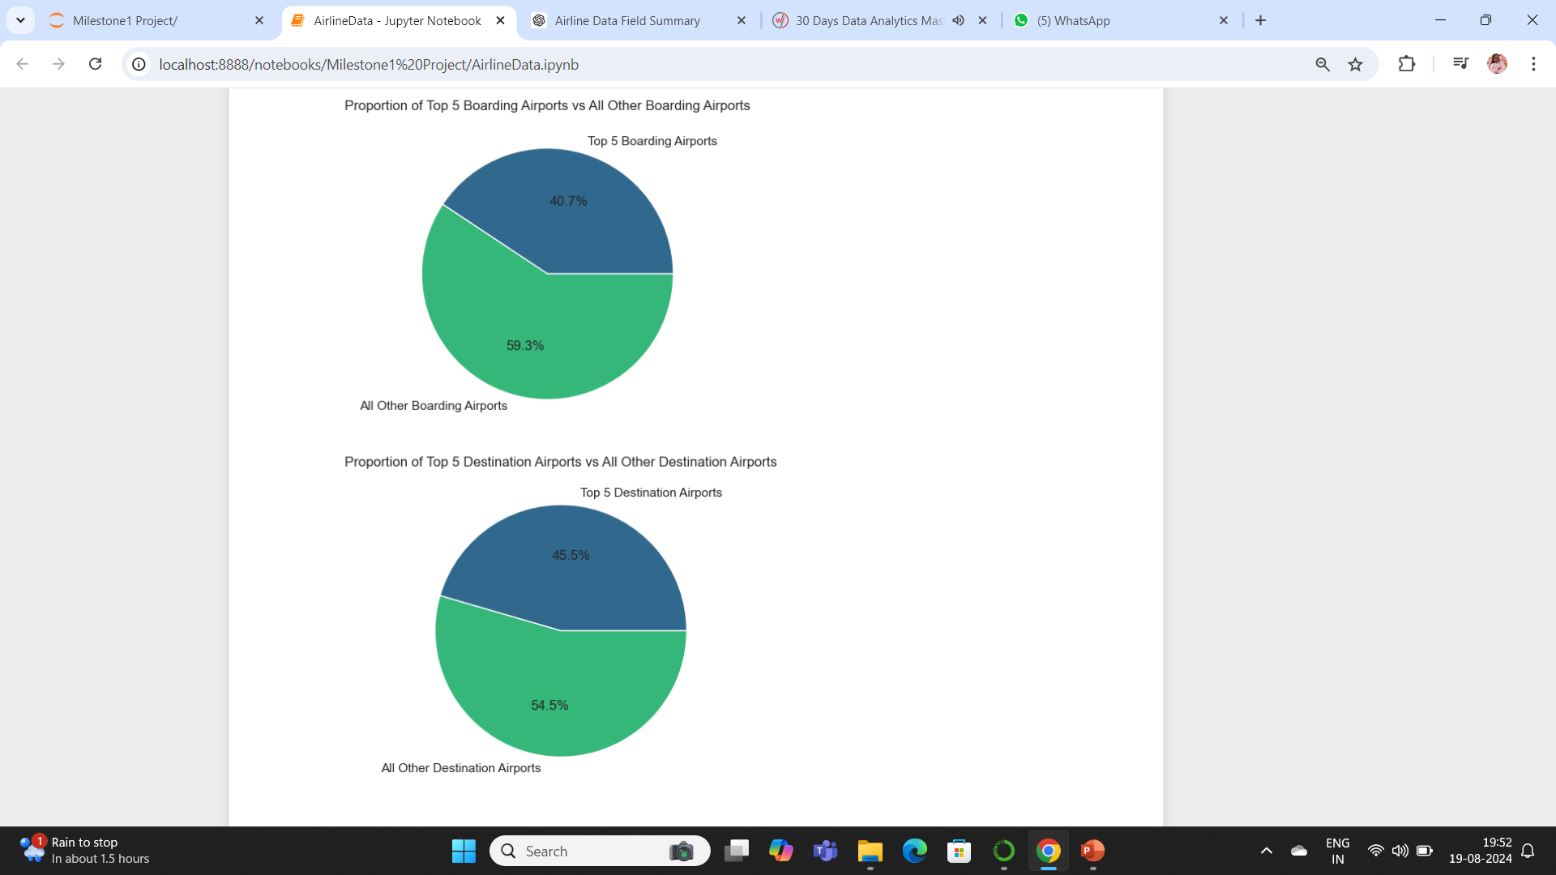

Slide 24
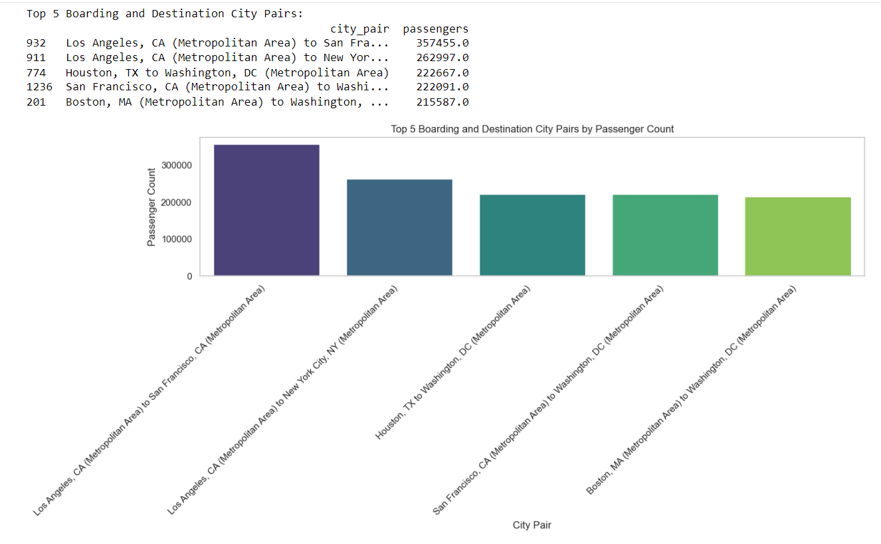
TOP 5 CITY PAIRS

Slide 25
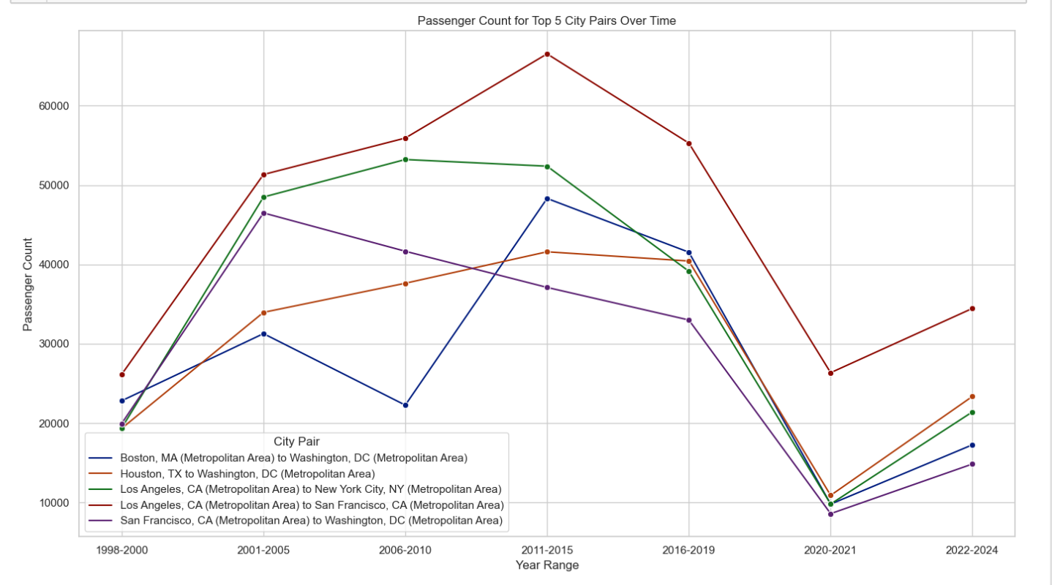
PASSENGER POPULATION TRENDS FOR TOP 5 CITY PAIRS

Slide 26
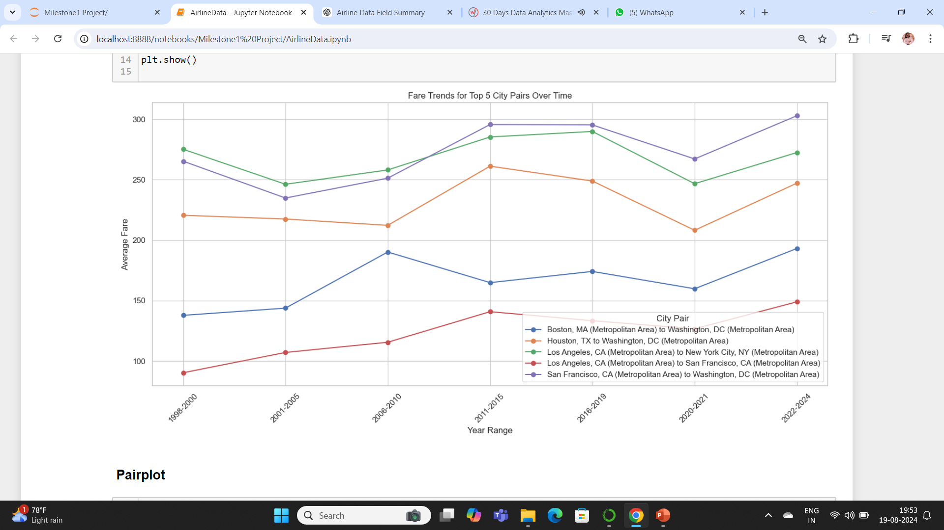
FARE TRENDS FOR TOP 5 CITY PAIRS

Slide 27
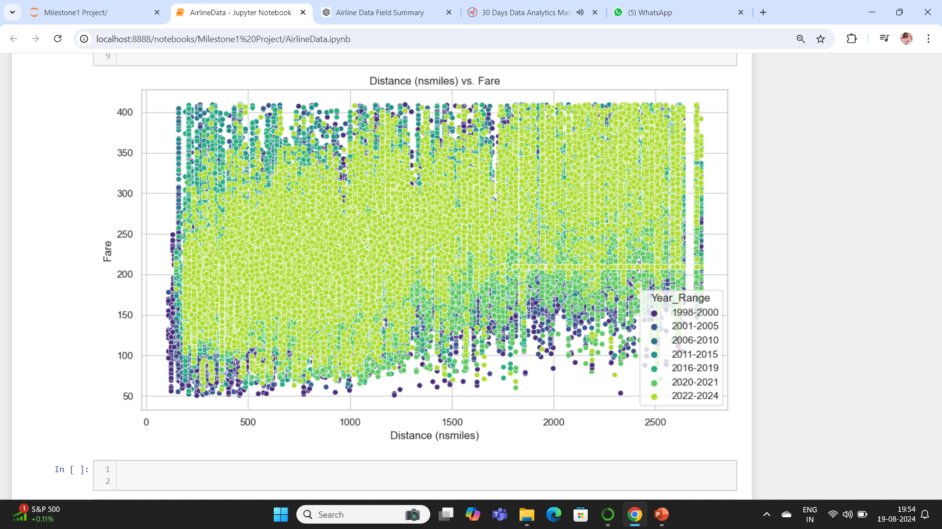
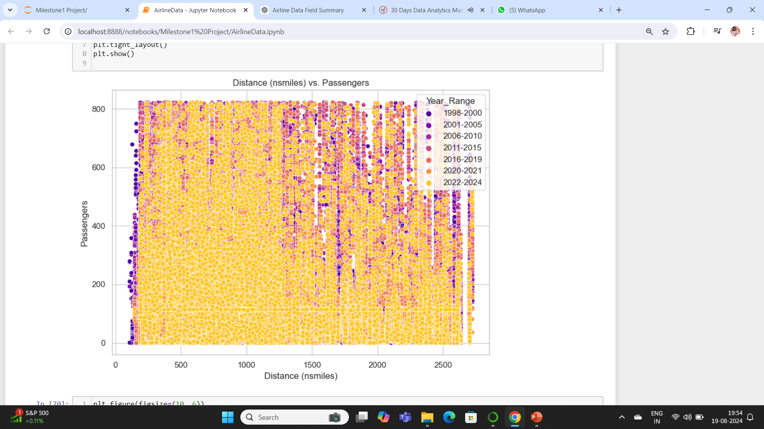
SCATTER PLOTS

Slide 28
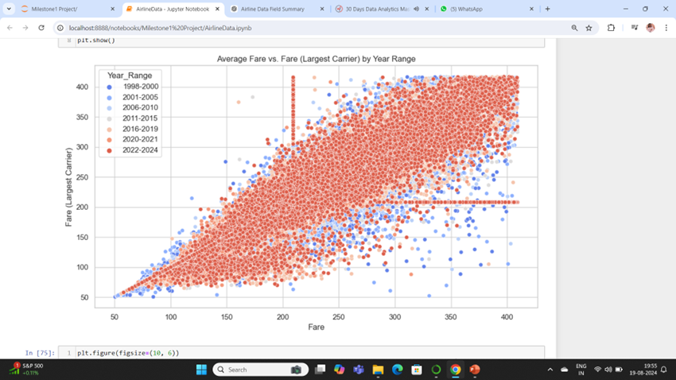
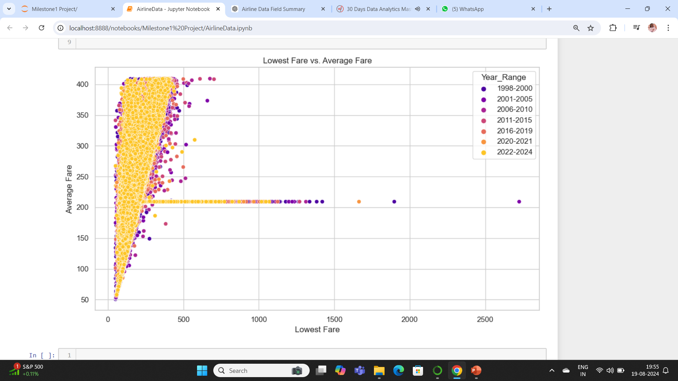
AVERAGE FARE Vs
CARRIER LARGE FARE
CARRIER LOW FARE

Slide 29
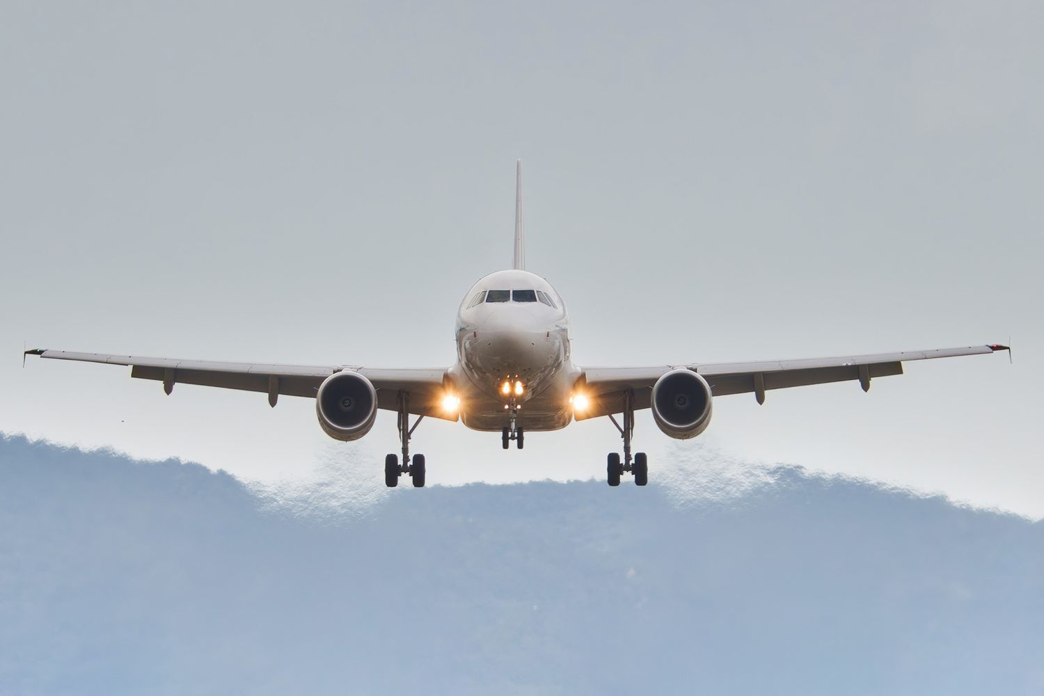
STATISTICAL TESTS
One-Way ANOVA Test
Chi-Square Test
To determine if there is a statistically significant difference in the average number of passengers across different year ranges.
F-Statistics: 103.44
p-Value: 1.30e-45
Result:
Reject the null hypothesis at alpha = 0.05.
There is a statistically significant difference in the average number of passengers between the year ranges 2001-2005, 2006-2010, and 2011-2015.
To assess if there is a significant association between the year range and city pairs.
Degrees of Freedom (df): 6,762
p-Value: 0.0
Result:
Reject the null hypothesis at alpha = 0.05.
There is a statistically significant association between year range and city pair. This suggests that the distribution of city pairs changes significantly across different years.

Slide 30


